Slide 1
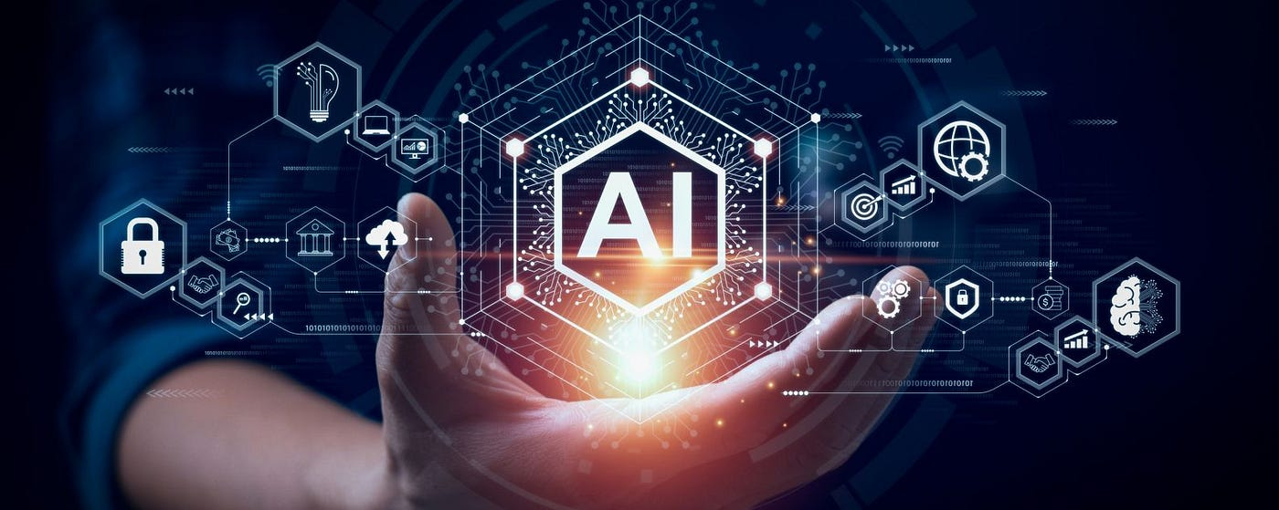
The Future of Artificial Intelligence in daily Life
Presentation by -Abhinav Kumar

Slide 2
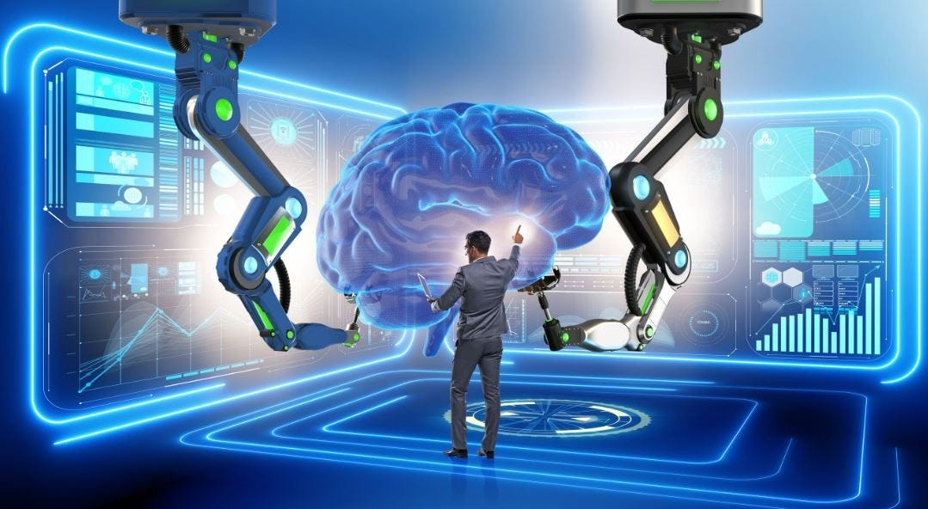
The Future of Artificial Intelligence in Daily Life
Subtitle: Transforming the Way We Live, Work, and Connect
Presented by: [Your Name]
Date: [Presentation Date]

Slide 3
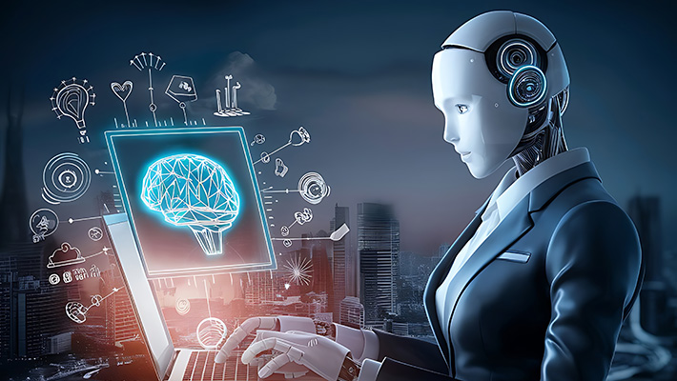
Introduction
What is Artificial Intelligence (AI)?
Brief history of AI
Why AI matters today

Slide 4
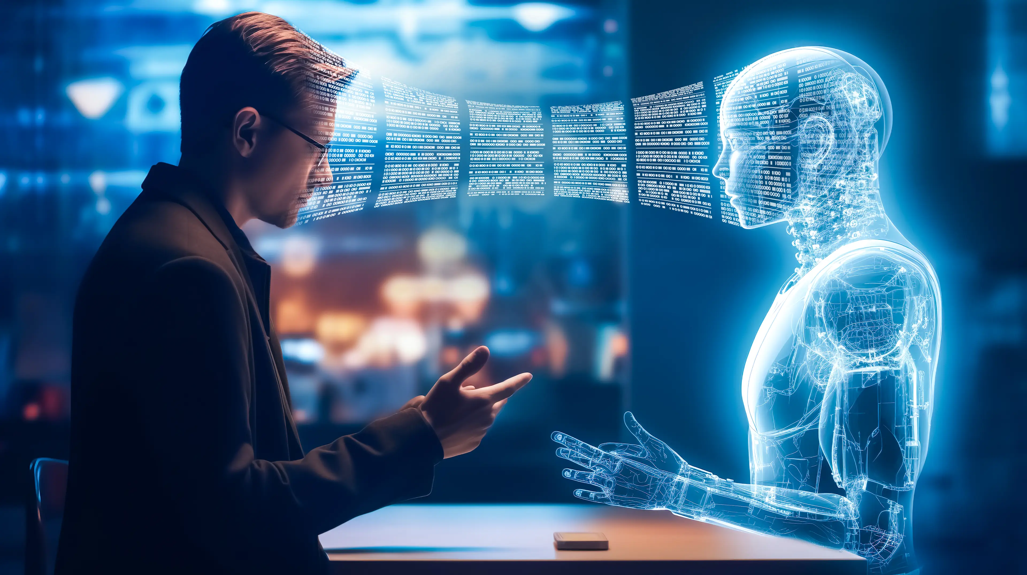
AI in Communication
Smart assistants (Siri, Alexa, Google Assistant)
Language translation tools
Chatbots in customer service

Slide 5
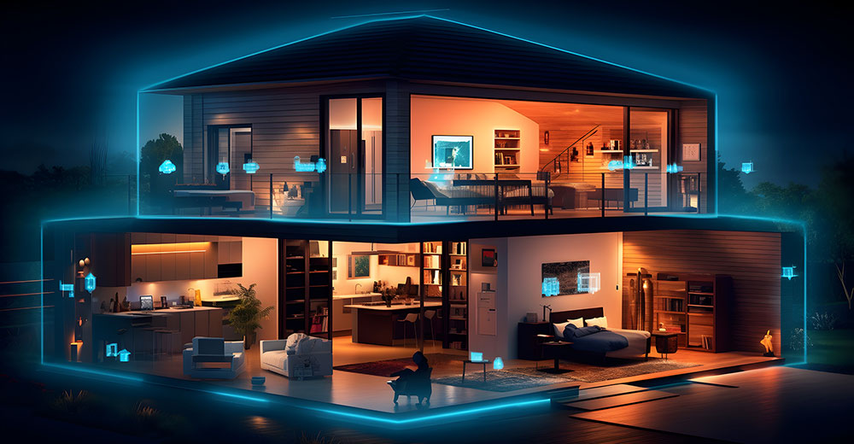
AI in the Home
Smart home devices (thermostats, lights, security)
Personalized recommendations (streaming platforms, shopping)
AI-powered appliances

Slide 6
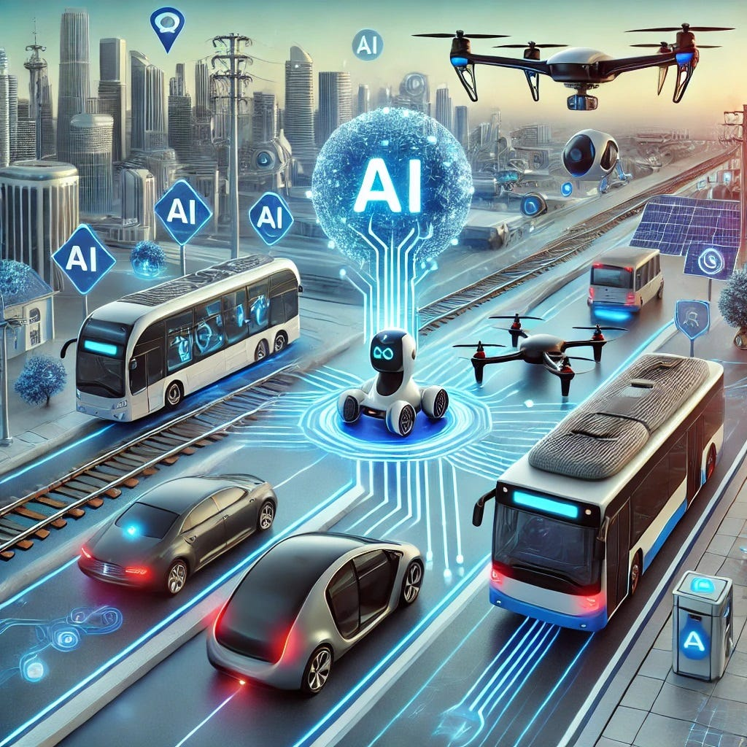
AI in Transportation
Autonomous vehicles
Traffic and route optimization (Google Maps, Waze)
Ride-sharing algorithms (Uber, Lyft)

Slide 7
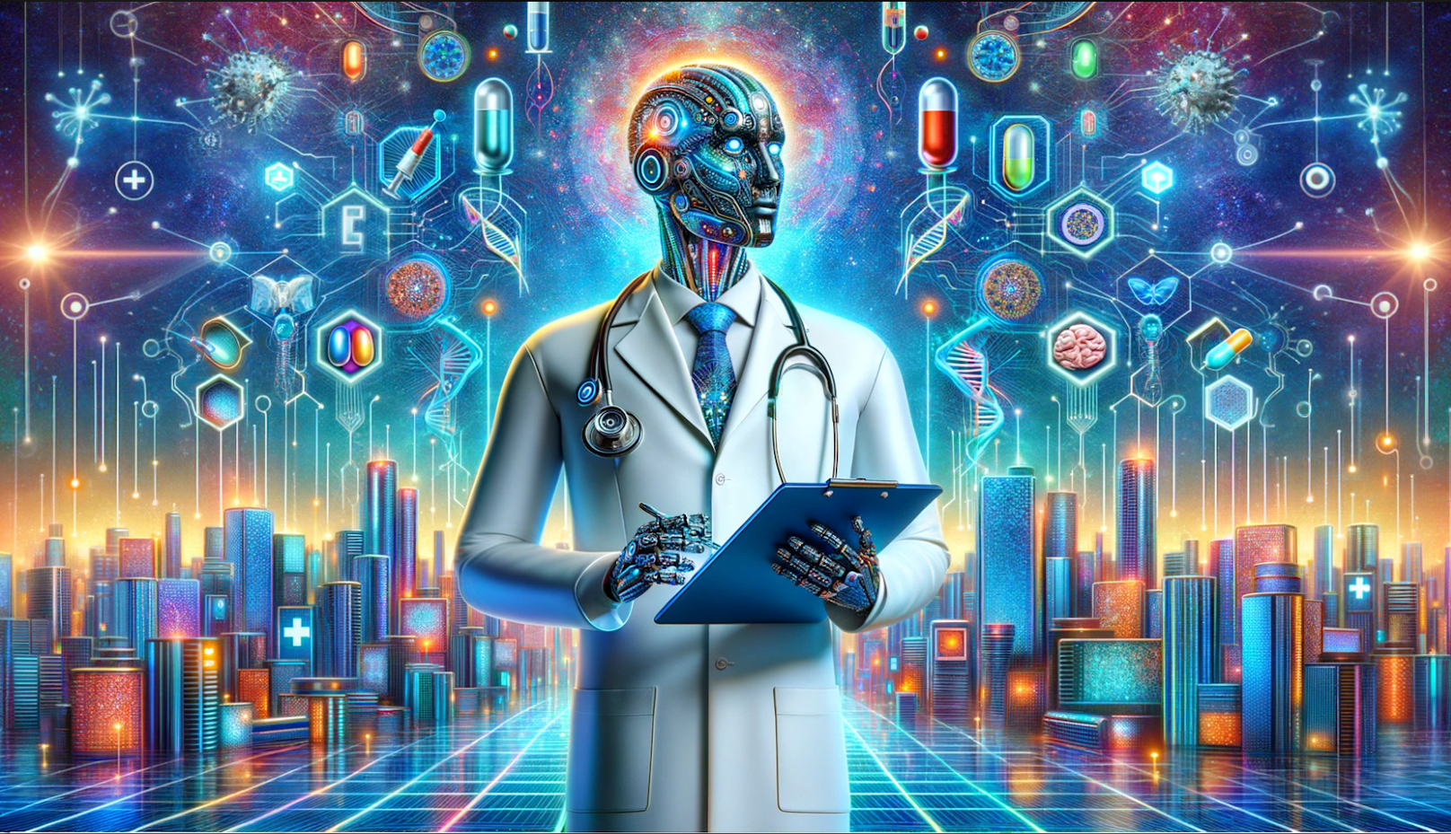
AI in Healthcare
Diagnostic tools (image recognition for X-rays, MRIs)
Personalized medicine
Virtual health assistants

Slide 8
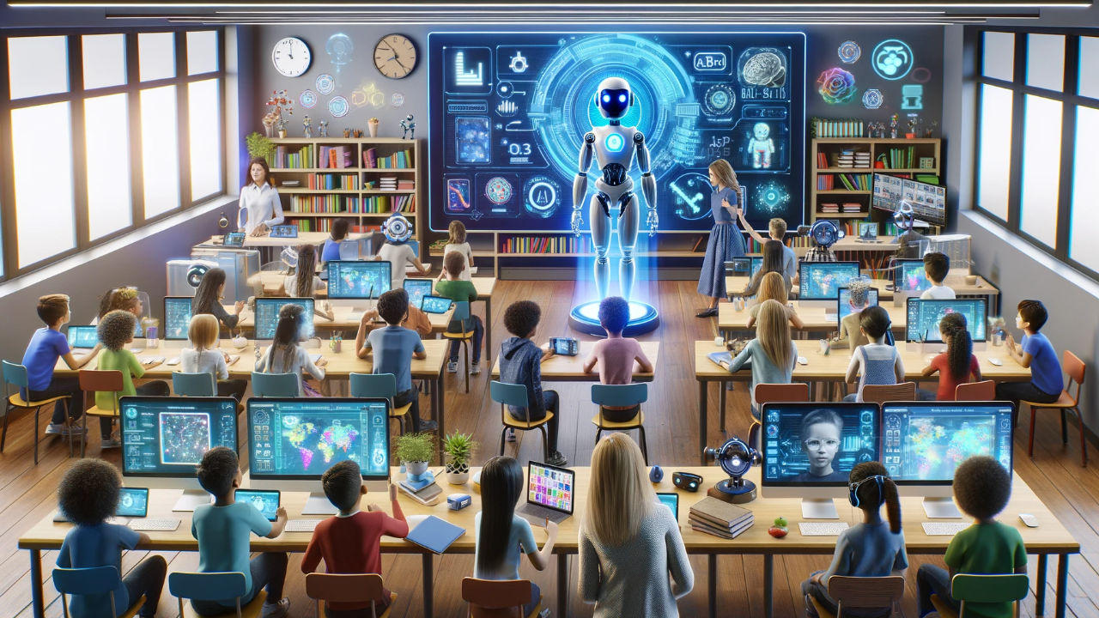
AI in Education
Personalized learning platforms
Virtual tutors and assistants
Automated grading systems

Slide 9
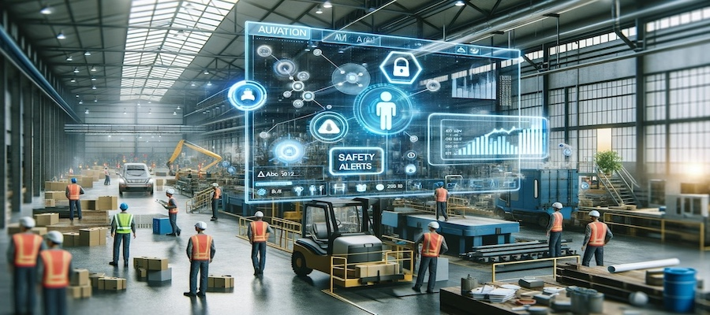
AI in Workplaces
Automation of repetitive tasks
Data analysis and decision-making support
AI in HR (resume screening, performance tracking)

Slide 10
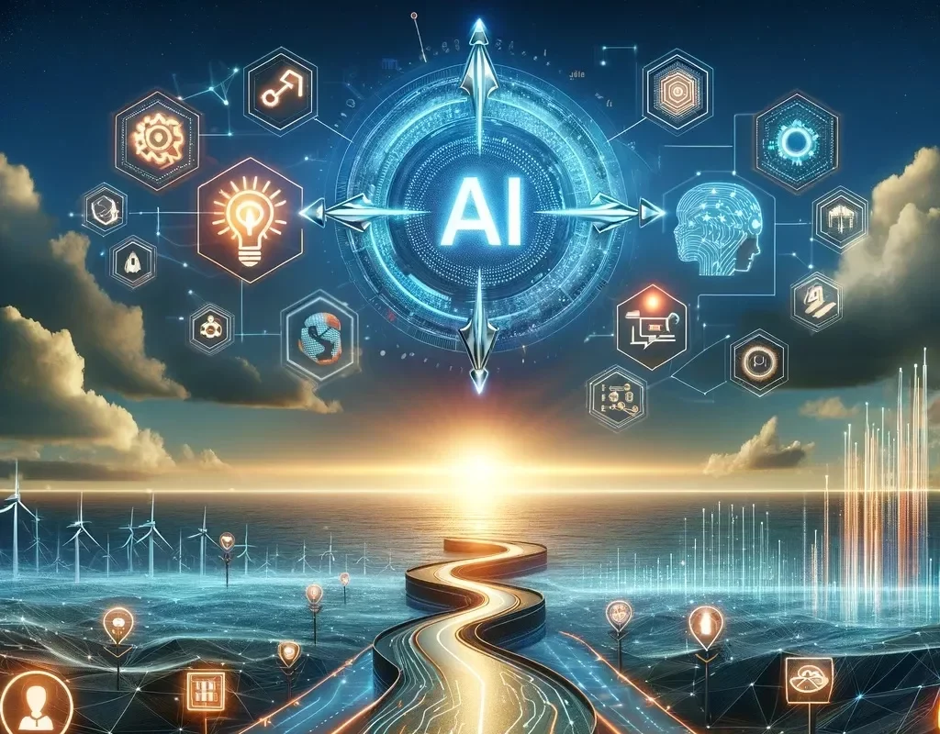
The Road Ahead
Future innovations (AI + AR/VR, robotics)
AI in sustainability (energy, agriculture)
Emphasis on responsible AI development

Slide 11
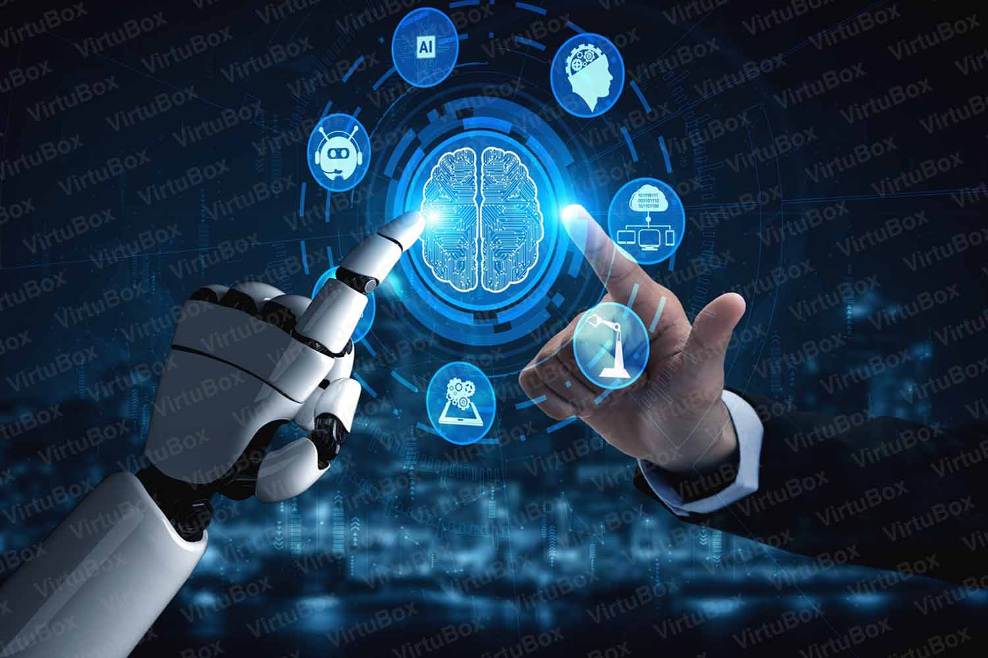
Conclusion
AI is increasingly integral to daily life
Benefits must be balanced with ethical considerations
The future is AI-enhanced, not AI-replaced

